Slide 1



The Army Components
The Army Components

Slide 2
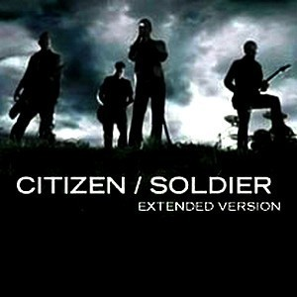
Why Cover the Components? We are One Army
The Army Components
To provide all prospective Inspector General students -- Active Component, National Guard, and U.S. Army Reserve Soldiers; members of other Armed Services; and Department of the Army Civilians (DAC) -- with a fundamental understanding of the uniqueness of the various Army Components within the context of the Army IG system.

Slide 3
Army Force Structure
(943,100 Soldiers and ~260,000 Civilians)
The Army Components
49% of the Generating Forces are in the two Reserve Components
60% of the Operating Forces are in the two Reserve Components
65% of the Inspectors General are in the Active Component

Slide 4
References
The Army Components
The Army Components’ Inspectors General (Part 6, The IG Reference Guide)
Profile of the Army
AR 20-1, Inspector General Activities and Procedures, Chapter 1

Slide 5
Terminal Learning Objective
The Army Components
Action: Support active-duty, Army Reserve, and Army National Guard commands and organizations as part of an active-component, Army Reserve, or Army National Guard Inspector General office.
Conditions: Given The Inspector General Reference Guide (Part 6), classroom handouts, and classroom instruction.
Standard: Identify the command structure of the Army Reserve and the Army National Guard and describe several of the unique Army Reserve and Army National Guard programs, systems, and readiness issues.

Slide 6
Enabling Learning Objectives
ELO
The Army Components
Describe the overall command-and-control system of the Army, specifically the Army National Guard (ARNG) and the U.S. Army Reserve (USAR)
Describe the requirements and duties of the U.S. Property and Fiscal Officer (USPFO)
Describe the various Full-Time Support (FTS) programs used within the ARNG and the USAR

Slide 7
Enabling Learning Objectives
(continued)
The Army Components
Describe the various duty and corresponding pay statuses
Describe the Incapacitation Pay Program and common problem areas and areas of concern
Describe the types and phases of mobilization

Slide 8
Safety and Environmental
The Army Components
Safety Requirements: No other specific safety requirements are unique to this block of instruction per DA PAM 385-30, Risk Management, dated 2 December 2014.
Risk Assessment Level: Low in accordance with TRADOC Regulation 385-2, U.S. Army Training and Doctrine Command Safety and Occupational Health Program, dated 14 June 2024.
Environmental Considerations: None in accordance with AR 200-1, Environmental Protection and Enhancement, dated 13 December 2007, and ATP 3-34.5, Environmental Considerations, dated January 2024.

Slide 9
Army / ARNG / USAR
References
The Army Components
USC Title 10
USC Title 32
AR 135 Series (ARNG and USAR)
AR 140 Series (USAR)
NGRs
USARC Regulations
AR 600-20, Army Command Policy
AR 525-29 Force Generation-Sustainable Readiness
AR 71-32, Force Development
AR 10-87, Army Commands, Army Service Component Commands, Direct Reporting Units
General Orders

Slide 10
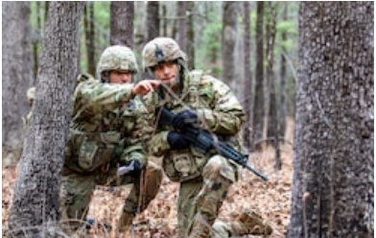
Just a Few Army Acronyms
The Army Components
RC - Reserve Component(s)
IRR - Individual Ready Reserves
IMA - Individual Mobilization Augmentation
TPU - Troop Program Unit
IDT - Inactive-Duty Training
M-Day - Mobilization-Day Soldier
FTS - Full-Time Support
MFGI - Mobilization Force Generation Installation

Slide 11

Just a Few Army Acronyms (continued)
The Army Components
MCU - Multiple-Component Unit
ACOM - Army Command
ASCC - Army Service Component Command
DRU - Direct Reporting Unit
DARNG - Director, Army National Guard
CNGB - Chief, National Guard Bureau
CAR - Chief, Army Reserve
ARA - Army Reserve Administrator (Unit Administrator)

Slide 12

The Army
The Army Components
COMPO 1 = Active Component
COMPO 2 = Army National Guard
COMPO 3 = Army Reserve
MULTI-COMPO = A unit, on a single document, that is authorized personnel and / or equipment from more than one component.

Slide 13
Army Command Structure
ELO
1
The Army Components

Slide 14
Active Army
The Army Components
COMPO 1

Slide 15
Legal Basis for
Active Component
The Army Components
Title 10, United States Code, Section 3075
“The regular Army is the component of the Army that consists of persons whose continuous service on active duty in both peace and war is contemplated by law, and of retired members of the Regular Army.”

Slide 16
Active Component -
Mission
The Army Components
The U.S. Army’s mission is to deploy, fight and win our Nation’s wars by providing ready, prompt, and sustained land dominance by Army forces across the full spectrum of conflict as part of the Joint Force.
www.goarmy.com/

Slide 17
United States
Army National Guard
The Army Components
COMPO 2

Slide 18
Legal Basis for
Army National Guard
The Army Components
Title 32, United States Code, Section 10107
“In accordance with the traditional military policy of the United States, it is essential that the strength and organization of the Army National Guard and the Air National Guard as an integral part of the first line defenses of the United States be maintained and assured at all times.”

Slide 19
Army National Guard - Mission
The Army Components
To serve as the primary combat reserve, seamlessly providing enduring, rotational, surge, and follow-on forces with trained, ready, and interoperable units to fight and win the nation’s wars, defend the homeland, and support our communities in times of crisis.
Army National Guard 2014-2020 Strategic Planning Guidance

Slide 20
Dual Missions for
National Guard
The Army Components
Federal: To maintain combat-ready units and trained personnel available to mobilize and deploy in support of the National Military Strategy.
State: To function efficiently for the protection of life and property and to preserve peace, order, and public safety under State authorities.

Slide 21









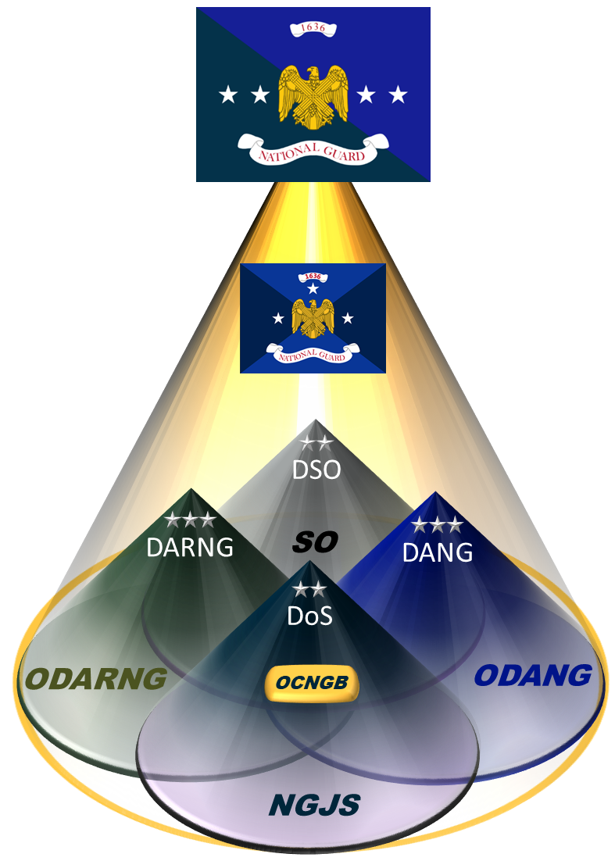
National Guard C2
ELO
1
Federal
Title 10
The Army Components
President
State
Title 32
Congress
SecDef
Governor
SecArmy
SecAF
CSAF
The Adjutant General
CSA
CNGB
Army National Guard
Units
Air National Guard
Units
Director,
Army National Guard
Director,
Air National Guard
IG Reference Guide, Part 6

Slide 22
National Guard Key Personnel at the State
The Army Components
Chief, National Guard Bureau (CNGB)
Governor
The Adjutant General (TAG) (Army or Air NG)
Senior Army Advisor, Army National Guard (SRAAG)
United States Property & Fiscal Officer (USPFO)

Slide 23
TAG and SRAAG
The Army Components
The Adjutant General (TAG) (Army or Air NG)
  - De facto commander of state’s military forces
  - Responsible for overall management, readiness and mobilization of military forces
  - Senior military advisor to the Governor
Senior Army Advisor, Army National Guard (SRAAG)
  - Active Army officers detailed with ARNG
  - Advise and assist with organization , operations, training and readiness
  - Principle active component contact (ATFP enabler)

Slide 24
USPFO Roles and Responsibilities
ELO
2
The Army Components
Commissioned ARNG or ANG Officer on Title 10 status
The Adjutant General (TAG) recommends, the Governor nominates, and the CNGB appoints
Work for and responsible to CNGB with duty in a state
Provides technical assistance and advice to TAG on the proper use of Federal funds
Controls and oversees all Federal funds and property of the U.S. Government issued to the State
First Army IG inspects USPFOs on behalf of FORSCOM
CNGBI 9501.01, July 2021, National Guard Bureau United States Property and Fiscal Officer Program; DoDI 1200.18, The United States Property and Fiscal Officer (USPFO) Program

Slide 25
United States Army Reserve
The Army Components
COMPO 3

Slide 26
Legal Basis for
Army Reserve
The Army Components
Title 10, United States Code, Section 10104
“To provide trained units and qualified persons available for active duty in the armed forces, in time of war or national emergency and at such other times as the national security requires, to fill the needs of the armed forces whenever, during, and after the period needed to procure and train additional units and qualified persons to achieve the planned mobilization, more units and persons are needed than are in the regular components.”

Slide 27
Army Reserve - Mission
The Army Components
To Provide COMBAT-READY units and Soldiers to the Army and Joint Force ACROSS THE FULL SPECTRUM OF CONFLICT.
https://www.usar.army.mil/About-Us/

Slide 28


Army Reserve
Command and Control
ELO
1
The Army Components
HQDA
CSA
FORSCOM
OCAR
USARC
GEOGRAPHIC CMDS
FUNCTIONAL CMDS
IG Reference Guide, Part 6 and www.usar.army.mil/Commands/

Slide 29
Reserve Categories
Total Reserve
Manpower
The Army Components
Standby
Reserve
Ready
Reserve
Retired
Reserve

Slide 30
Standby Reserve
Standby
Reserve
The Army Components
ARNG and USAR SM (normally senior)
Fully Trained (MOSQ)
Involuntarily mobilized
Key Civilian Employees
Temporary hardship or disability
Do not train and are not in units
Full Mobilization in time of war

Slide 31
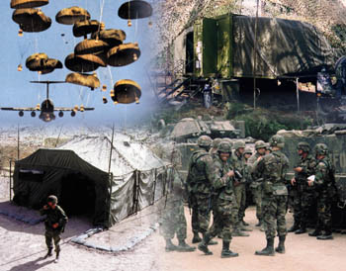
Ready Reserve
The Army Components
Ready
Reserve
Individual
Ready Reserve
Inactive
National Guard
Selected
Reserve
Partial Mobilization

Slide 32
Ready Reserve
Individual Ready Reserve (IRR)
The Army Components
Managed by HRC, Fort Knox
Various Control Groups
Soldiers have served in AC or selected reserves
Fully or partially trained (MOSQ)
May not have completed service obligation
Voluntary or Involuntary
Can obtain retirement points
Partial Mobilization (up to 1 million, 24 months)

Slide 33
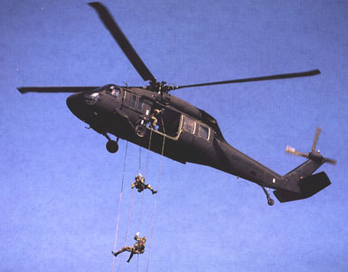
Ready Reserve
Inactive Army National Guard
The Army Components
  ARNG only
  Non-participating unit members
  Records maintained by State
  Yearly muster required
  Partial Mobilization (involuntary)

Slide 34
Ready Reserve
Selected Reserve
The Army Components
Trained
Personnel
Units
Army National Guard Units
Mobilization Day (M-Day)/ Drilling Guardsman
Drill and 15-Day Annual Training
Army Reserve Units
Troop Program Unit (TPU) Soldiers
Battle Assembly and 14-Day Annual Training
Active Guard Reserve (AGR)
Individual Mobilization Augmentees (IMA)

Slide 35
Retired Reserve
Retired
Reserve
The Army Components
Three Types of Retirees
  AC = Records transferred to Fort Knox
  RC = Under age 60: “Gray Area”
  RC = Over age 60: available to receive pay / benefits
Involuntary recall to active duty
Retirement is a process

Slide 36

RC Full-Time Support
(FTS)
ELO
3
The Army Components
Active Guard Reserve (AGR)
Military Technician (MILTECH)
Department of Army Civilian (DAC)
Active Component (AC)
IG Reference Guide, Part 6

Slide 37
Full-Time Support
(continued)
The Army Components
Active Guard / Reserve (AGR)
ARNG, Title 10 or 32
USAR, Title 10
Purpose is to support readiness of M-Day and TPU units
Military Technician (MILTECH)
Dual-Status Personnel (Required)
ARNG - Wears uniform during week
USAR - Wears civilian clothes during week

Slide 38
Full-Time Support
(continued)
The Army Components
Department of Army Civilian (DAC)
Civilian employees not requiring dual status in unit
Active Component (AC)
First Army and Training Support Divisions
  Training, Readiness, Mobilization, Deployment
MCUs – organizational authorizations
Command / Leadership Exchange Program

Slide 39
    Compensation
ELO
4
The Army Components
AC (Title 10) - Paid every day of the month
AGR USAR (Title 10) - Paid every day of the month
AGR ARNG (Title 10 & Title 32) - Paid every day of the month
  - ARNG Miltech
IG Reference Guide, Part 6

Slide 40
    Compensation
    (continued)
The Army Components
Army Reserve Unit USAR (Title 10) - Paid for battle assemblies (IDT) and annual training (AT)
  USAR Miltech paid as a civilian separately
Mobilization-Day (M-Day) ARNG (Title 32) - Paid for drill weekend duty (IDT) and annual training (AT)

Slide 41
    Compensation
    (additional)
The Army Components
USAR and ARNG (Reserve Income Replacement Program) – Paid to eligible Soldiers when mobilized for extended periods
  Soldiers are paid the difference between their civilian salary and their total military compensation
  To be eligible, Soldiers must be on involuntary active duty
  - have completed 18 consecutive months of active duty, or
  - completed 24 cumulative months of active duty during the previous 60 months
  - involuntarily mobilized for more than 180 days within 180 days of returning from a mobilization of 180 days or more
  Extended to 31 December 2024
  For more information contact Department of Veterans Affairs, Military OneSource or Service personnel offices;
  DoD 7000.14-R Financial Management Regulation Vol 7A, Ch 55

Slide 42
    Incapacitation Pay (INCAP)
ELO
5
Pay for injury/illness of RC Soldiers resulting from Official Duty
The Army Components
Injury must result in loss of non-military earned income as a result of injury, illness, or disease incurred or aggravated while in the line of duty
Line of Duty (LOD) determination must be “Yes” (AR 600-8-4)
Pay retroactive on a month-to-month basis (DA Form 7574)
May not exceed 6 months, unless authorized by SecArmy
AR 135-381, Incapacitation of RC Soldiers
Potential for FRAUD
IG Reference Guide, Part 6

Slide 43
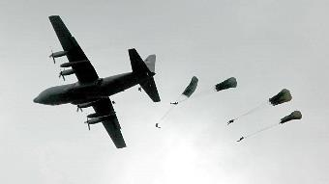
Mobilization
The Army Components

Slide 44
Types of Mobilization
ELO
6
The Army Components
No personnel limitation
Duration plus 6 months; Involuntary
Congressional Declaration of War or National Emergency
FULL
MOBILIZATION
10 USC 12301 (a)
Congress
President
Secretary of Defense
Service Secretary
Maximum 1M; Requires POTUS
Declaration of National Emergency
24 consecutive months; Involuntary
For officially named operations
PARTIAL
MOBILIZATION *
10 USC 12302
Maximum 200K Ready Reserve & 30K IRR
365 days; Involuntary
Requires Executive Order
PRESIDENTIAL RESERVE CALL UP
10 USC 12304 **
RESERVE EMERGENCY CALL UP
10 USC 12304a *
No personnel limitation
120 days; Involuntary
No National Guard
RESERVE PRE-PLANNED CALL UP ISO COCOMs
10 USC 12304b *
Maximum 60K
365 days; Involuntary
Mission / costs in Defense Budget
Annual Training / Operational
Mission; Involuntary
Governor’s consent
15 DAY-STATUTE *
10 USC 12301 (b)
ACTIVE DUTY FOR OPERATIONAL SUPPORT *
10 USC 12301 (d)
Voluntary
Governor’s consent
Can be used for operational
missions or service support
Mobilization authorities currently used or available for use(*)
12304 requires specific POTUS approval prior to utilization (**)
All Services access RC utilizing these authorities in conjunction with DoD policies
Access incomplete without associated funding allocated to Services to manage
Access = Authority + Funding
IG Reference Guide, Part 6

Slide 45
Phases of Mobilization
ELO
6
The Army Components
Phase I
Phase II
Phase III
Phase IV
Pre-Mobilization
Alert
Mobilization
De-Mobilization
*Home station
*Planning
*Funding Request
*HQDA Alert Order
*Deployment Order Published
*Specific Mission TRNG (Home station)
*Sustainment Planning
*Mobilization Prep
*Assemble HS
*Move to MFGI
POE
*Post MOB Training
(First Army)
*DSCA=HS Training
*POD
*Move back to MFGI
*Requirement Based Demobilization Process (RBDP)
Notes:
ISSUES THAT THE IG SHOULD ANTICIPATE AND ATTEMPT TO GET TO THE LEFT OF…
NON-SUPPORT OF FAMILY MEMBERS
PAY ISSUES: HAZARDOUS DUTY PAY/FAMILY SEPARATION PAY, DEPENDING UPON THE TYPE OF ORDERS THE SM IS ON
LEAVE: ALL COMP’S EARN LEAVE ONCE ON AD FOR 30 DAYS - MISSION REQ’S MIGHT IMPEDED SM’S FROM TAKING LEAVE, MUST USE OR CASH IT OUT
ORDERS: HOR ISSUES, MOST COMMON ORDERS ARE TCS ORDERS - THESE ORDERS CAN BE AMENDED TO MEET OPERATIONAL REQ’S ALONG THE WAY

Slide 46
Check on Learning
The Army Components
What is unique about the command-and-control of the Army National Guard? And the Army Reserve?
  National guard has dual role: federal and state
  Army Reserve is both a component and a command
Describe the requirements for and duties of the U.S. Property and Fiscal Officer (USPFO)
  Commissioned Officer on Title 10 who a TAG recommends, the Governor nominates, and the CNGB appoints, who work for the NGB with duty in a state
  Controls and oversees all Federal funds and property issued to the State

Slide 47
Check on Learning
The Army Components
Describe the various duty statuses and corresponding pay plan.
  Active Duty/AGR – paid for every day; TPU and M-day paid for duty completed or when on orders
What is the purpose of incapacitation pay?
  Replace pay lost from RC Soldier’s civilian work as the result of injury or illness incurred in the line of duty

Slide 48
TLO Check on Learning
The Army Components
Why is it important for IGs to know about dimensions of the Army Components?
Because the Army does not function (and especially does not deploy) as discrete units or components; IGs of one component must be prepared to execute the IG functions, to work all issues, no matter to which component the IG (or complainant) may belong.
The Inspector General Reference Guide (Part 6)

Slide 49
Summary
The Army Components
Described the overall command-and-control system of the Army, specifically the National Guard and the Army Reserve
Described the requirements and duties of the U.S. Property and Fiscal Officer (USPFO)
Described the various Full-Time Support (FTS) programs used within the NG and USAR
Described the various duty and pay statuses
Described the Incapacitation Pay Program and common problem areas and areas of concern
Describe the types and phases of mobilization

Slide 50

Questions?
The Army Components

